Slide 1
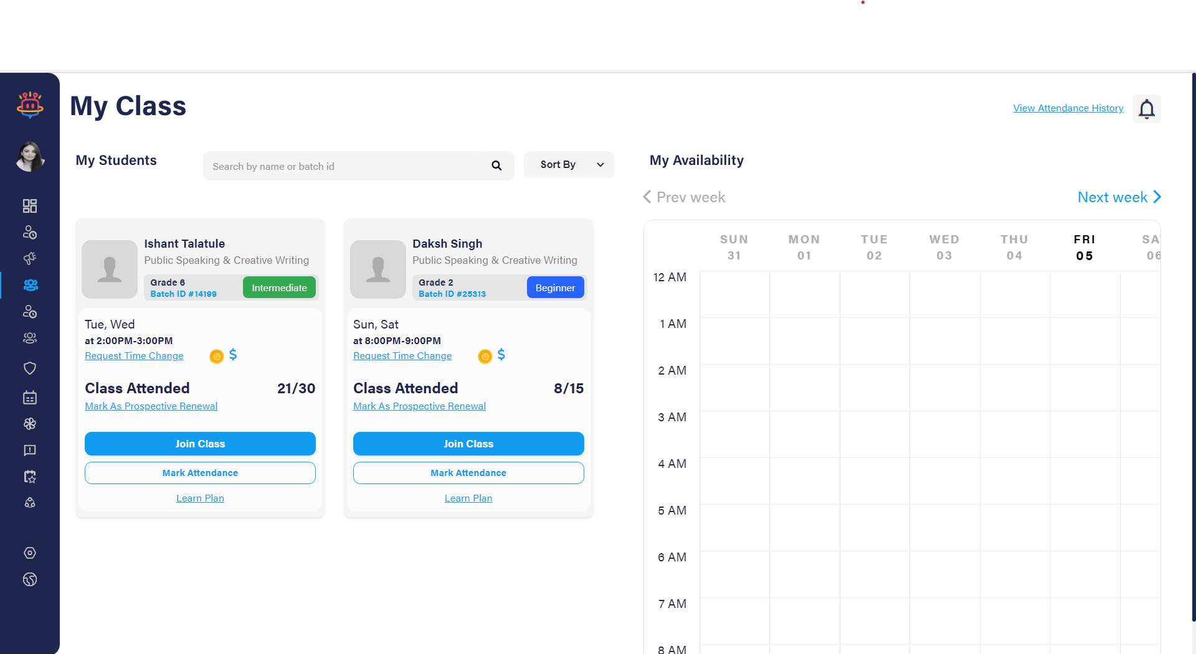
Main screen

Slide 2
Content (main screen)
Timetable of the teacher- it will show the upcoming classes for the week
Join class- it will generate a google meet link that the students can join
Mark attendance
Ratings of the teacher

Slide 3
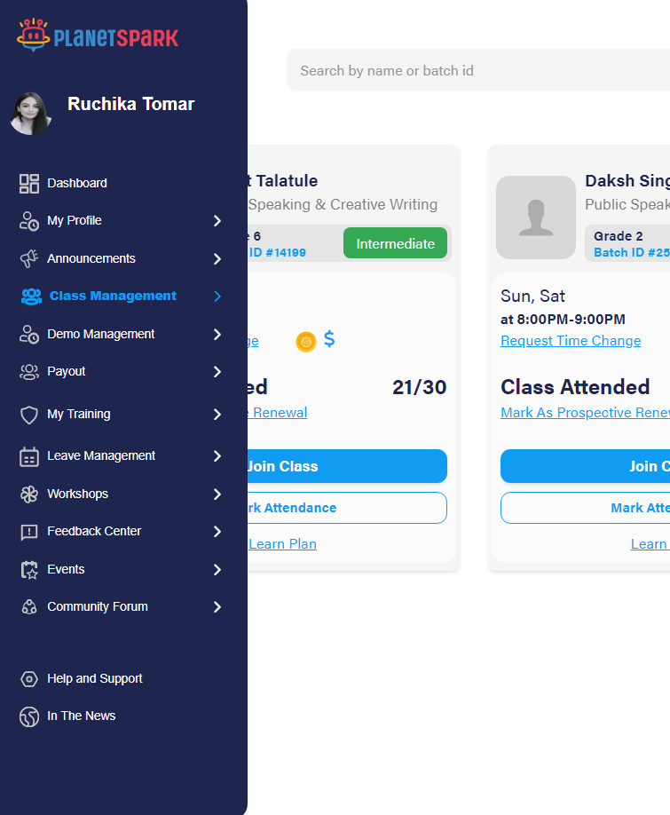
Menu (left side of the screen)

Slide 4
Content (menu)
Dashboard
My profile
Class management
Demo management
Leave management
Payout
Training
Study material
support

Slide 5
CLASS MANAGEMENT
Upcoming classes
Feedback schedule

Slide 6
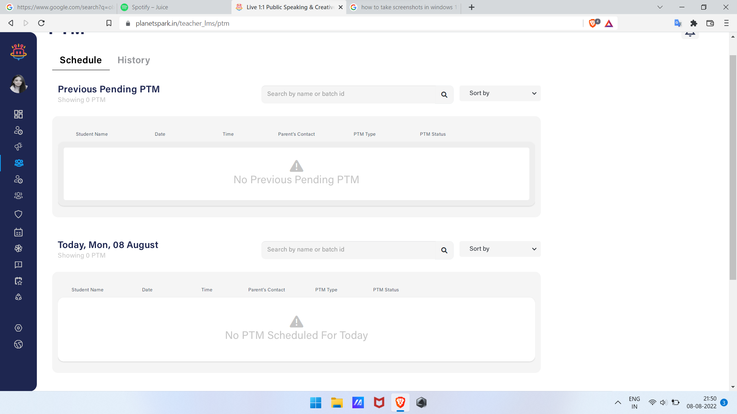
Feedback schedule

Slide 7
Upcoming Classes

Slide 8
Demo management
Schedule demo
Upcoming demos
Previous demos

Slide 9
Training
Overall progress (percent completed)
Training modules

Slide 10
Study material
Download study material ( student’s study material)
Upload study material

Slide 11
Student signup
Student login
Name
Contact
Email
Confirm with OTP
City
Referral code

Slide 12
Purchase course
Subscription for
IELTS full course
IELTS beginner
IELTS intermediate
IELTS advanced
IELTS one section only= academic/ general
Specific interview preparation = enter your requirement.
Book a free demo

Slide 13
After purchasing a course
Profile- upload photo (optional)
Selection of time slot

Slide 14
Dashboard
H.W.
Download study material
Weekly progress test schedule
Results and assessments by teachers= internal
External
Attendance
feedback for teachers

Slide 15
Refer a student click name and contact.
Notifications= teacher feedback.

Slide 16
Admin control
Slot fixing for teachers and students
Slots of teachers available
Feedback from teachers and students
Fixing the weekly test and notifying both teachers and students
Feedback for both with list of teachers and students
Request acceptance and denial
Course changes
Delete an account
Change password for any account

